Slide 1
Data Analytics vs. Data Science

Slide 2
Data Analytics vs. Data Science
Business Intelligence Analyst
Data Analyst
Data Scientist

Slide 3
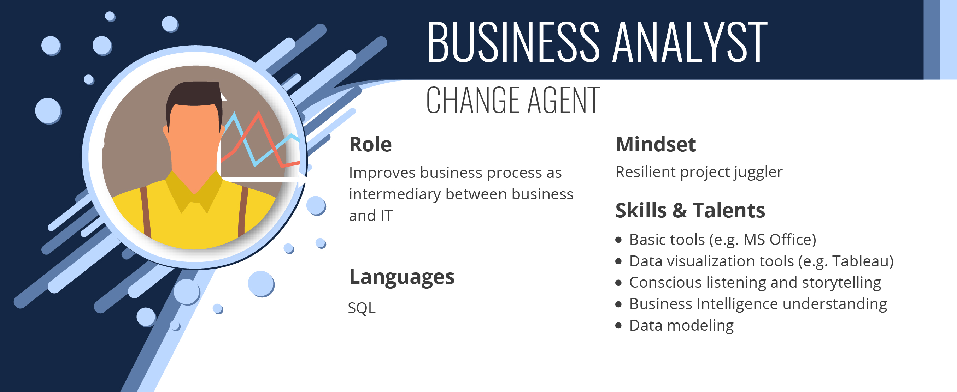

Slide 4
Business Metrics

Slide 5
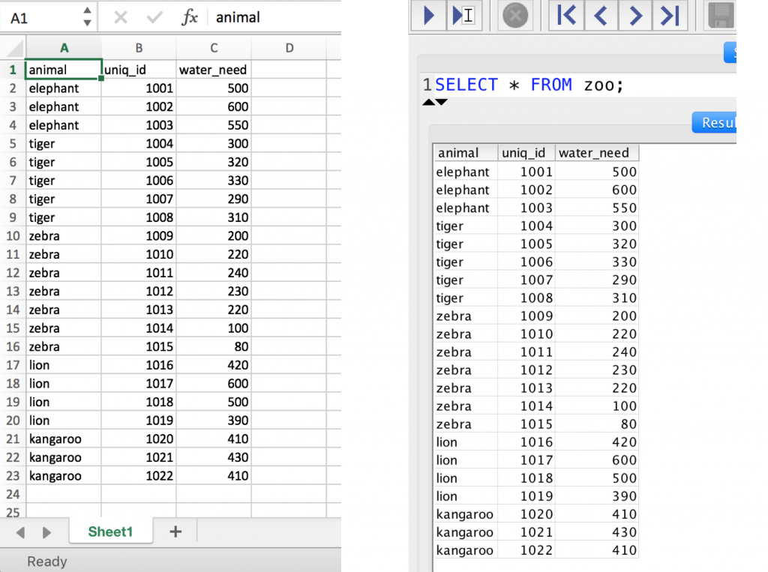



Slide 6
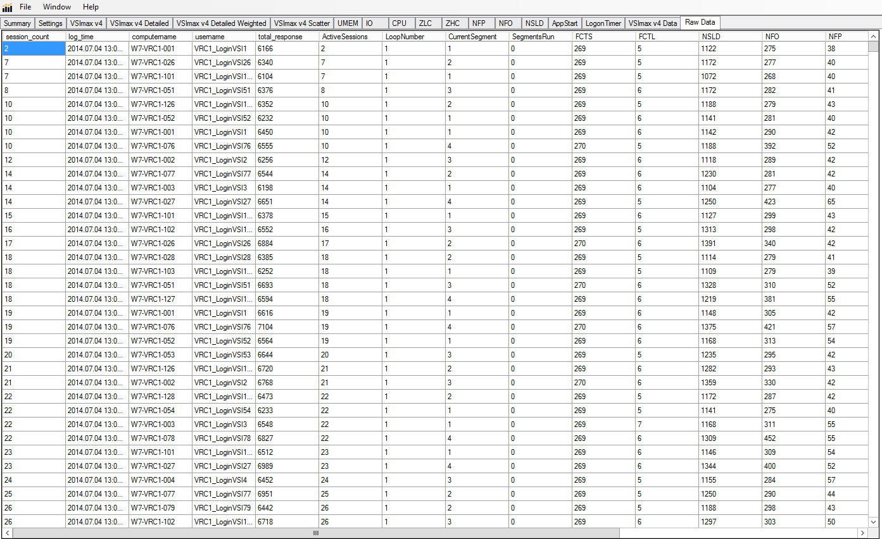

Slide 7
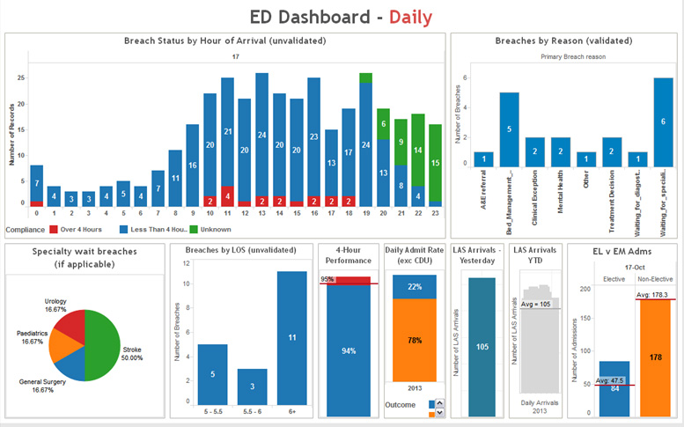
Dashboard

Slide 8


Business (BI) Analyst

Slide 9
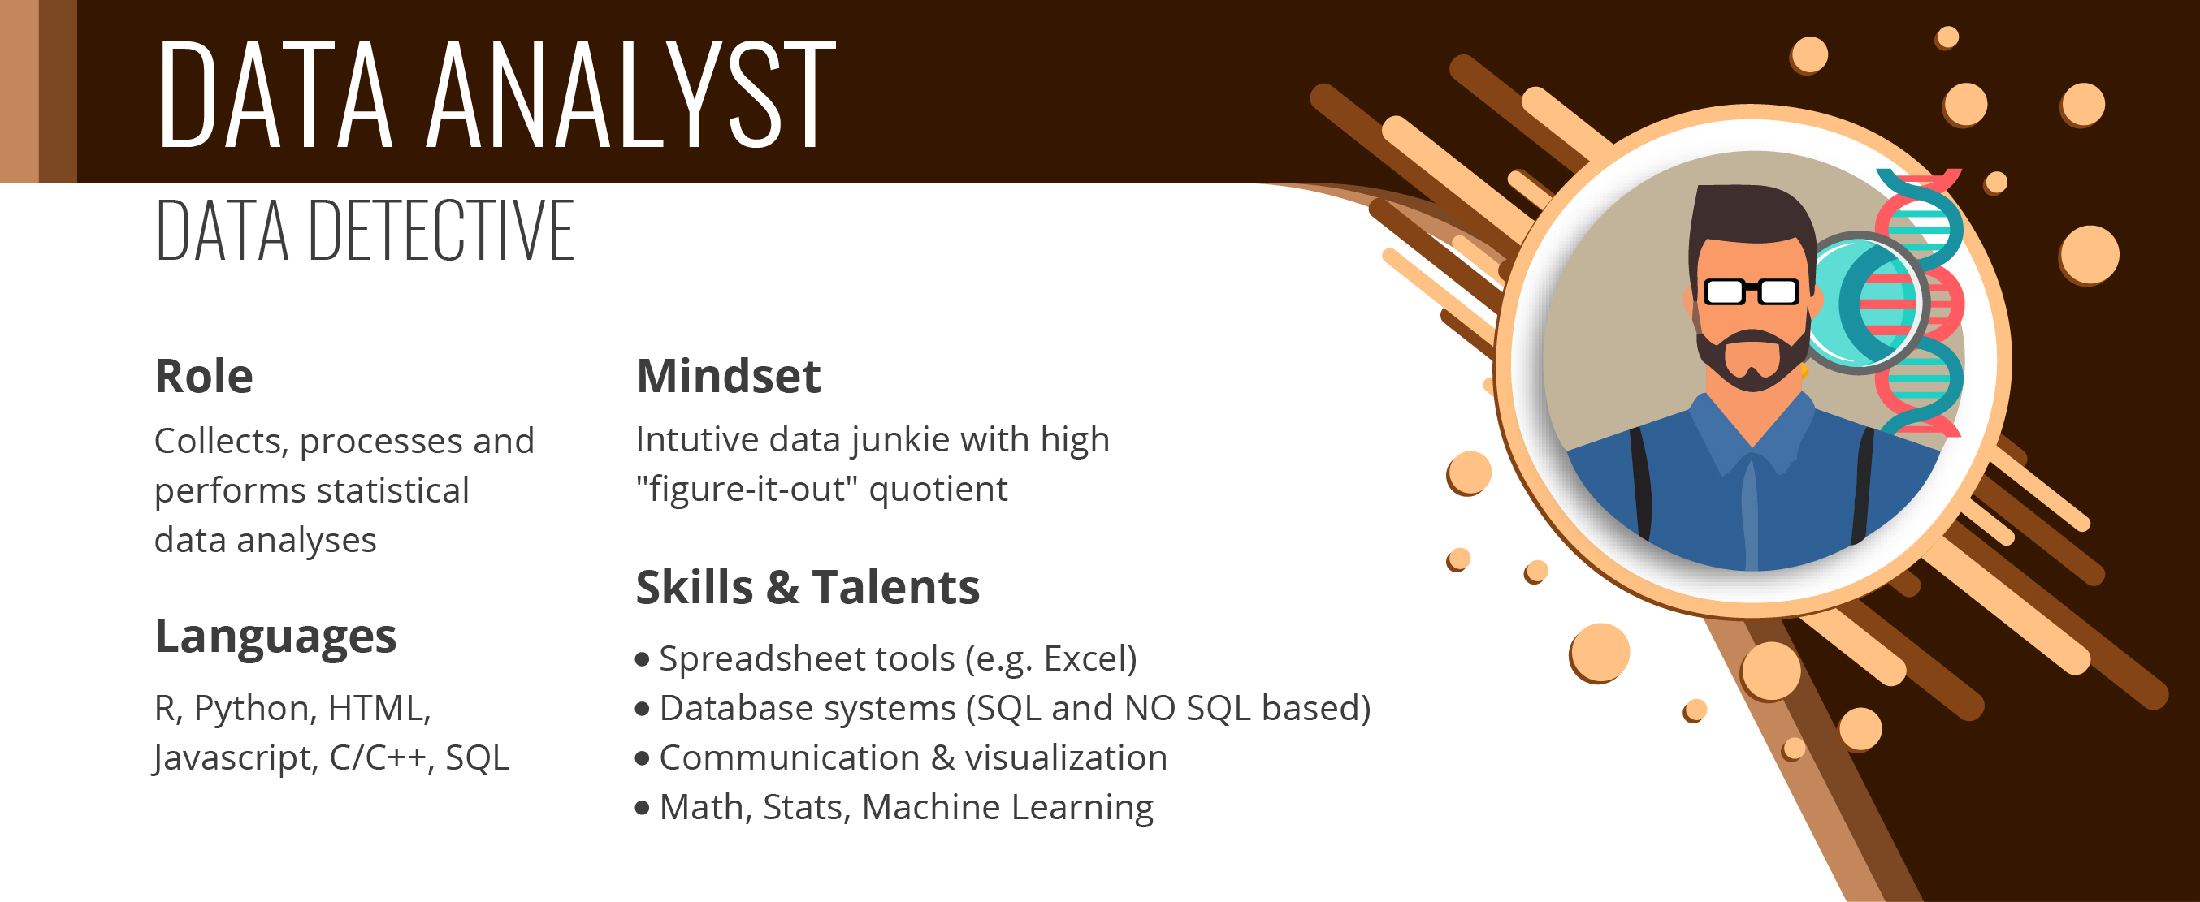

Slide 10
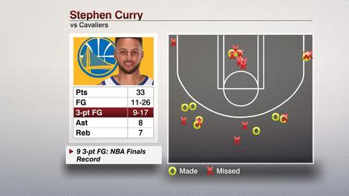

Slide 11


Slide 12
Data Analytics Stages
Category Purpose
Descriptive Analytics: What happened?
Exploratory Analytics: What’s important?
Predictive Analytics: What is likely to happen?
Prescriptive Analytics: What should I do?

Slide 13
Descriptive Analytics
Product Purchases
Age Groups | Monthly Transactions | Average Transaction Amt.
< 40 | 67 | $48.61
40 - 60 | 112 | $95.39
60 < | 43 | $61.22
Total | 222 | $68.40

Slide 14
Descriptive Analytics
Product Purchases
Age Groups | Monthly Transactions | Average Transaction Amt.
< 40 | 67 | $48.61
40 - 60 | 112 | $95.39
60 < | 43 | $61.22
Total | 222 | $68.40

Slide 15
Descriptive Analytics
Product Purchases
Age Groups | Monthly Transactions | Average Transaction Amt.
< 40 | 67 | $48.61
40 - 60 | 112 | $95.39
60 < | 43 | $61.22
Total | 222 | $68.40

Slide 16
Exploratory Analytics
Product Discounts
Gender | 20% | 30% | 40% | 50% | 60% | Ave.
Female | 14.99% | 17.61 | 20.92 | 20.73 | 26.08 | 20.06
Male | 9.76% | 15.23% | 16.90 | 20.16 | 26.74 | 17.75
Ave. | 12.38 | 16.42 | 18.91 | 20.45 | 26.41

Slide 17
Exploratory Analytics
Product Discounts
Gender | 20% | 30% | 40% | 50% | 60% | Ave.
Female | 14.99% | 17.61 | 20.92 | 20.73 | 26.08 | 20.06
Male | 9.76% | 15.23% | 16.90 | 20.16 | 26.74 | 17.75
Ave. | 12.38 | 16.42 | 18.91 | 20.45 | 26.41

Slide 18
Exploratory Analytics
Product Discounts
Gender | 20% | 30% | 40% | 50% | 60% | Ave.
Female | 14.99% | 17.61 | 20.92 | 20.73 | 26.08 | 20.06
Male | 9.76% | 15.23% | 16.90 | 20.16 | 26.74 | 17.75
Ave. | 12.38 | 16.42 | 18.91 | 20.45 | 26.41

Slide 19
Exploratory Analytics
Product Discounts
Gender | 20% | 30% | 40% | 50% | 60% | Ave.
Female | 14.99% | 17.61 | 20.92 | 20.73 | 26.08 | 20.06
Male | 9.76% | 15.23% | 16.90 | 20.16 | 26.74 | 17.75
Ave. | 12.38 | 16.42 | 18.91 | 20.45 | 26.41

Slide 20
Exploratory Analytics
Product Discounts
Gender | 20% | 30% | 40% | 50% | 60% | Ave.
Female | 14.99% | 17.61 | 20.92 | 20.73 | 26.08 | 20.06
Male | 9.76% | 15.23% | 16.90 | 20.16 | 26.74 | 17.75
Ave. | 12.38 | 16.42 | 18.91 | 20.45 | 26.41

Slide 21

Predictive Analytics

Slide 22

Predictive Analytics
Customer 360
Visited Website
Age
Called Sales
Gender
Responded to an email
Employment

Slide 23
Customer Data
Demographics
Name | Carl
Age | 38
Gender | M
Employed | Yes
Income | 75,000
Married | Y
Children | 2

Slide 24
Customer Data
Behavior
Visited Website | Y
Bought Products | N
Received Emails | Y
Responded to Emails | N
Tweeted About You | N
Called Sales | Y

Slide 25
Real-Time Customer Data
Clicked Product | Viewed Summary | Clicked Similar Product | Compared Products | Checked Reviews | Buy
1 | 1 | 0 | 0 | 1 | 1
1 | 0 | 1 | 1 | 0 | 0
1 | 1 | 1 | 0 | 1 | 1
0 | 0 | 0 | 0 | 0 | 0
1 | 0 | 1 | 0 | 0 | 0
1 | 1 | 1 | 0 | 1 | 1
1 | 1 | 0 | 1 | 0 | 1

Slide 26



Machine Learning Model
DATA
ALGORITHM
MODEL

Slide 27

Demographics
Website Actions

Slide 28
Machine Learning
Demographics
Propensity Model
Website Actions

Slide 29
Propensity Score
(how likely they are to buy from you)
Action Sequence | Will Buy?
Clicked Product | 10%
Viewed Summary | 20%
Clicked Similar | 25%
Compared Products | 55%
Checked Reviews | 70%
Machine Learning
Demographics
Propensity Model
Website Actions

Slide 30
Propensity Score
(how likely they are to buy from you)
Customer | Score
Sara | .73
Al | .38
Roberta | .92
Theresa | .47
Alice | .24
Bobby | .82
Machine Learning
Demographics
Propensity Model
Website Actions

Slide 31
New Customer
Clicked Product | Viewed Summary | Clicked Similar Product | Compared Products | Checked Reviews | Buy
0 | 0 | 0 | 0 | 0 | ?

Slide 32
New Customer
Clicked Product | Viewed Summary | Clicked Similar Product | Compared Products | Checked Reviews | Buy
0 | 0 | 0 | 0 | 0 | .03
Probability

Slide 33
New Customer
Clicked Product | Viewed Summary | Clicked Similar Product | Compared Products | Checked Reviews | Buy
1 | 0 | 0 | 0 | 0 | .09
Probability

Slide 34
New Customer
Clicked Product | Viewed Summary | Clicked Similar Product | Compared Products | Checked Reviews | Buy
1 | 0 | 1 | 0 | 0 | .27
Probability

Slide 35

New Customer
Clicked Product | Viewed Summary | Clicked Similar Product | Compared Products | Checked Reviews | Buy
1 | 0 | 1 | 0 | 1 | .59
Probability

Slide 36

Chat

Slide 37
Prescriptive Analytics
Day of the Week | Offers | Conversion%
Sunday | 736 | 17.8%
Monday | 707 | 15.7%
Tuesday | 767 | 19.3%
Wednesday | 732 | 15.0%
Thursday | 712 | 17.3%
Friday | 741 | 17.3%
Saturday | 605 | 33.4%
 | 5000 | 19.1%

Slide 38
Prescriptive Analytics
Day of the Week | Offers | Conversion%
Sunday | 736 | 17.8%
Monday | 707 | 15.7%
Tuesday | 767 | 19.3%
Wednesday | 732 | 15.0%
Thursday | 712 | 17.3%
Friday | 741 | 17.3%
Saturday | 605 | 33.4%
 | 5000 | 19.1%

Slide 39
Decision Analysis
Cost
Benefits
Saturday Campaign
Opportunities
Threats

Slide 40


Data Analyst
Domain Knowledge

Slide 41


Slide 42

Data Scientist

Slide 43
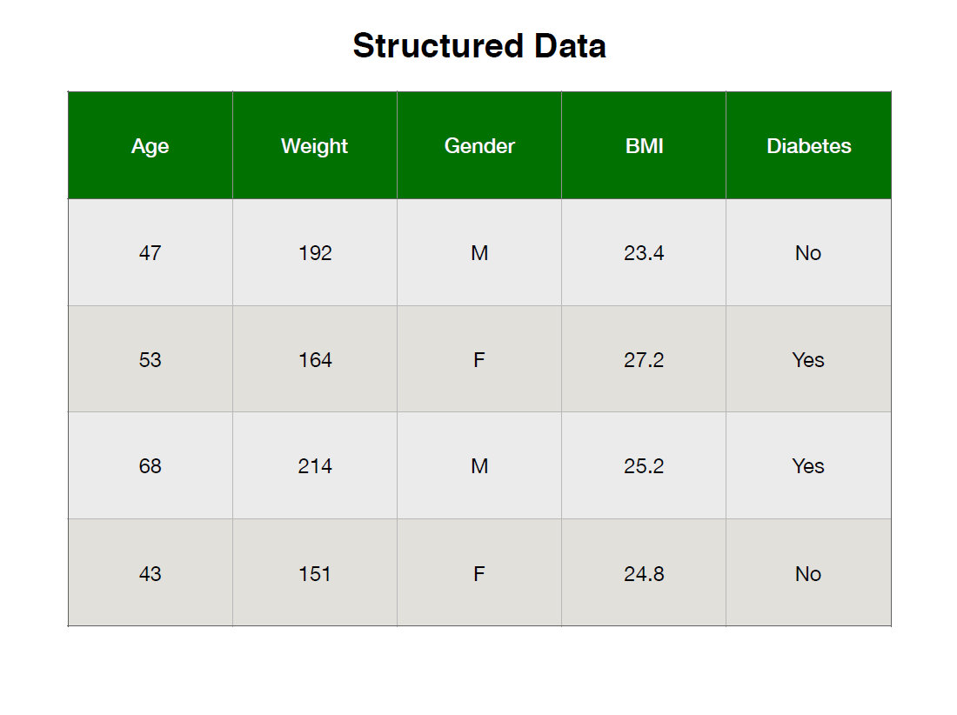

Slide 44
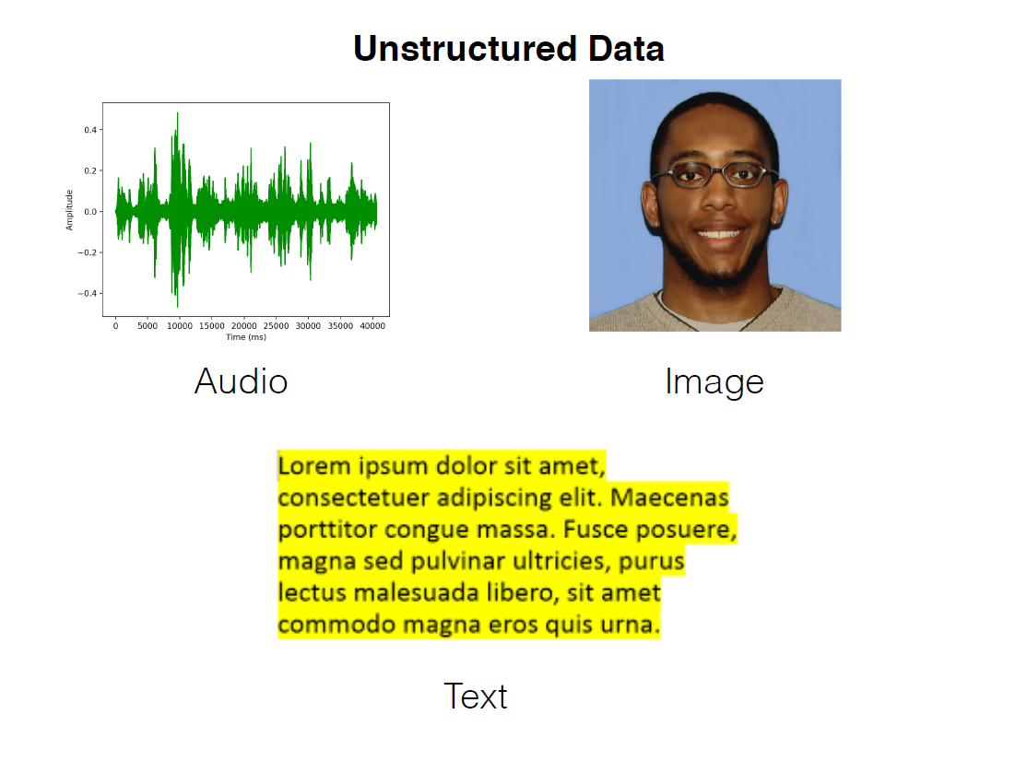

Slide 45




Slide 46
Comparison
Process | Data Engineering | Business Intelligence | Data Analytics | Data Science
Integrate Data Sources
Build Data Pipelines
Process and Transform Data
Store Data
Dashboards/Reports
Exploratory Analytics
Machine Learning
Specialized Domain Knowledge
Business Recommendations

Slide 47
Comparison
Process | Data Engineering | Business Intelligence | Data Analytics | Data Science
Integrate Data Sources | 
Build Data Pipelines | 
Process and Transform Data | 
Store Data | 
Dashboards/Reports
Exploratory Analytics
Machine Learning
Specialized Domain Knowledge
Business Recommendations

Slide 48
Comparison
Process | Data Engineering | Business Intelligence | Data Analytics | Data Science
Integrate Data Sources | 
Build Data Pipelines | 
Process and Transform Data | 
Store Data | 
Dashboards/Reports |  | 
Exploratory Analytics |  | 
Machine Learning
Specialized Domain Knowledge
Business Recommendations |  | 

Slide 49
Comparison
Process | Data Engineering | Business Intelligence | Data Analytics | Data Science
Integrate Data Sources | 
Build Data Pipelines | 
Process and Transform Data | 
Store Data | 
Dashboards/Reports |  |  | 
Exploratory Analytics |  |  | 
Machine Learning |  |  | 
Specialized Domain Knowledge |  |  | 
Business Recommendations |  |  | 

Slide 50
Comparison
Process | Data Engineering | Business Intelligence | Data Analytics | Data Science
Integrate Data Sources |  |  |  | 
Build Data Pipelines |  |  |  | 
Process and Transform Data |  |  |  | 
Store Data |  |  |  | 
Dashboards/Reports |  |  |  | 
Exploratory Analytics |  |  |  | 
Machine Learning |  |  |  | 
Specialized Domain Knowledge |  |  |  | 
Business Recommendations |  |  |  | 

